Slide 1




Linked Lists
Linked Lists
Notes:
Sequences

Slide 2
Singly Linked List
A singly linked list is a concrete data structure consisting of a sequence of nodes, starting from a head pointer
Each node stores
  element
  link to the next node
next
elem
node
head
∅
A
B
C
D
Linked Lists

Slide 3
The Node Class for List Nodes
public class Node {
// Instance variables:
private Object element;
private Node next;
/** Creates a node with null references to its element and next node. */
public Node() {
this(null, null);
}
/** Creates a node with the given element and next node. */
public Node(Object e, Node n) {
element = e;
next = n;
}
// Accessor methods:
public Object getElement() {
return element;
}
public Node getNext() {
return next;
}
// Modifier methods:
public void setElement(Object newElem) {
element = newElem;
}
public void setNext(Node newNext) {
next = newNext;
}
}
Linked Lists

Slide 4
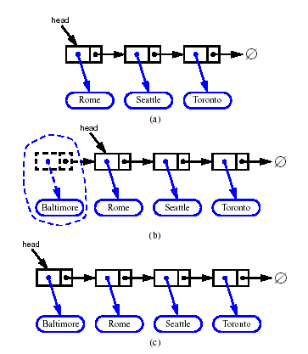
Inserting at the Head
Allocate a new node
Insert new element
Have new node point to old head
Update head to point to new node
Linked Lists

Slide 5
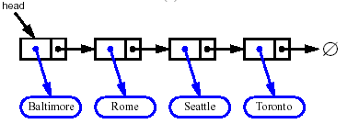


Removing at the Head
Update head to point to next node in the list
Allow garbage collector to reclaim the former first node
Linked Lists

Slide 6
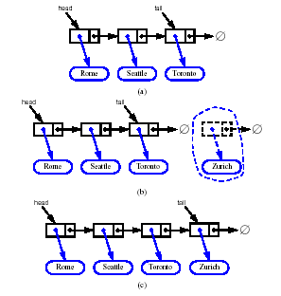
Inserting at the Tail
Allocate a new node
Insert new element
Have new node point to null
Have old last node point to new node
Update tail to point to new node
Linked Lists

Slide 7
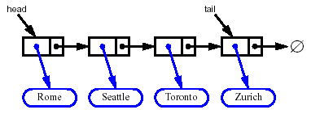
Removing at the Tail
Removing at the tail of a singly linked list is not efficient!
There is no constant-time way to update the tail to point to the previous node
Linked Lists

Slide 8
Stack as a Linked List
We can implement a stack with a singly linked list
The top element is stored at the first node of the list
The space used is O(n) and each operation of the Stack ADT takes O(1) time
nodes
t
∅
elements
Linked Lists

Slide 9
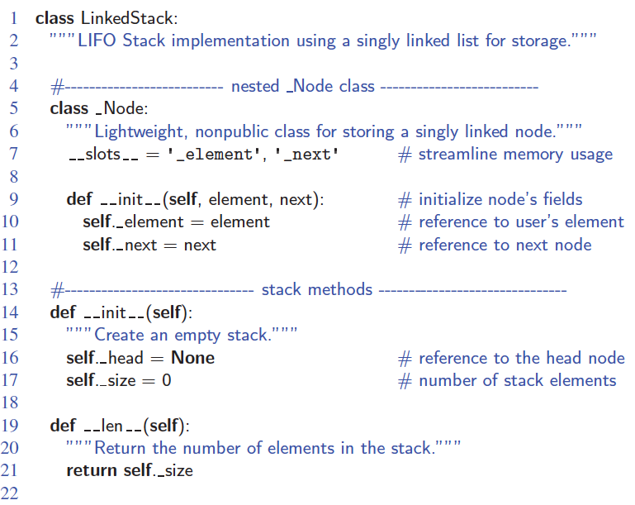
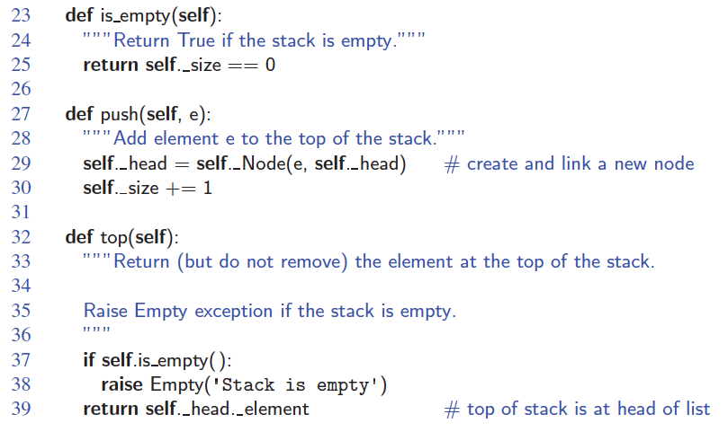
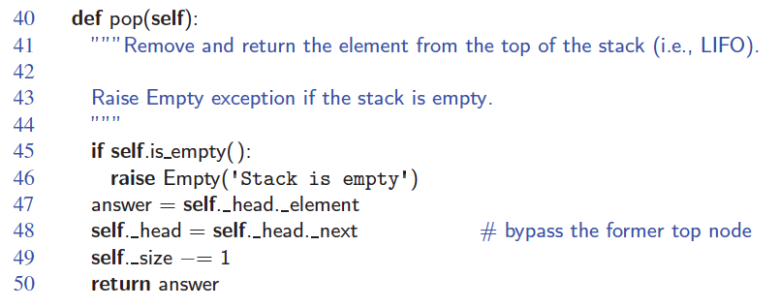
Linked-List Stack in Python
Linked Lists

Slide 10
Queue as a Linked List
We can implement a queue with a singly linked list
  The front element is stored at the first node
  The rear element is stored at the last node
The space used is O(n) and each operation of the Queue ADT takes O(1) time
r
nodes
f
∅
elements
Linked Lists

Slide 11
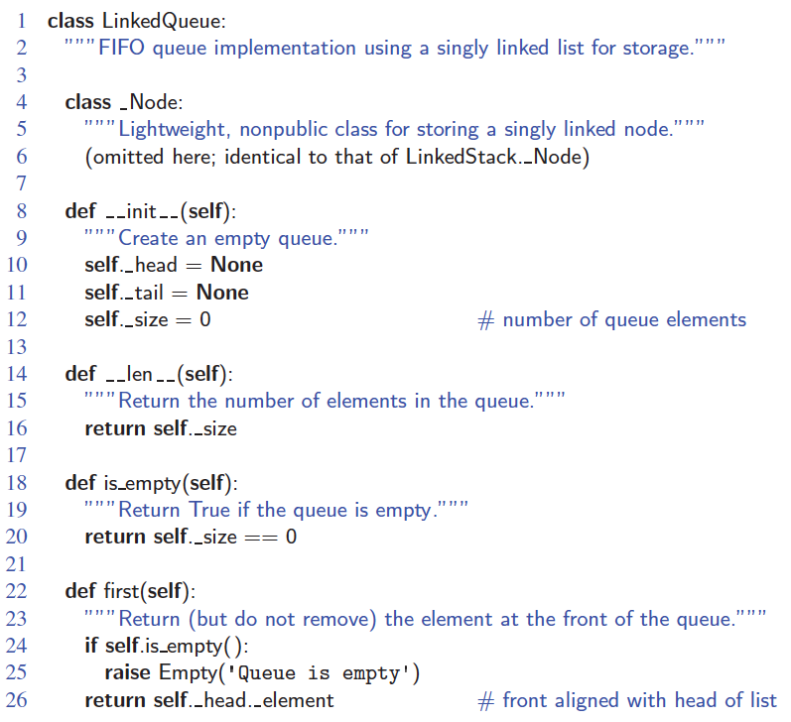
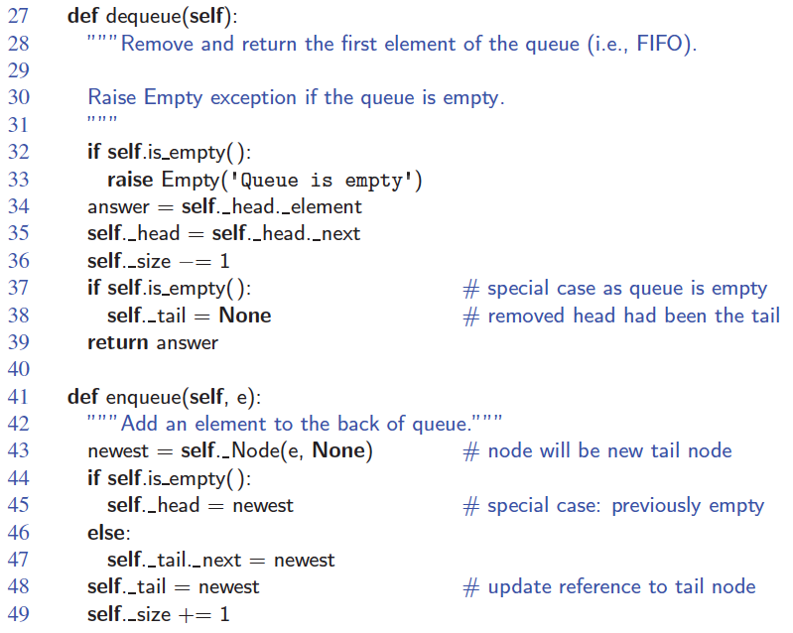
Linked-List Queue in Python
Linked Lists

